Slide 1

ETL Proyect
November 2019
“Los JSONS”

Slide 2
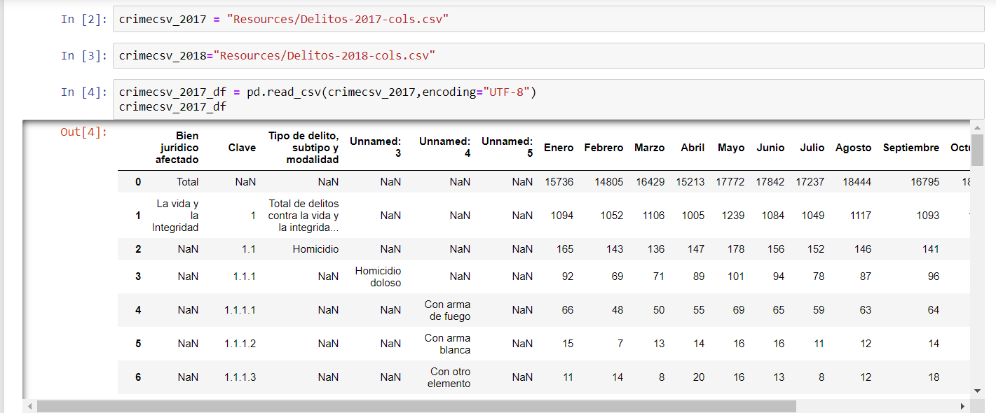
preview of the CVS

Slide 3

Reorganize and rename crime’s type and class
Rebuild DF
Select only the columns with relevant information (official data sets)
Finding relevant tweets about crime (unofficial data sets)

Slide 4
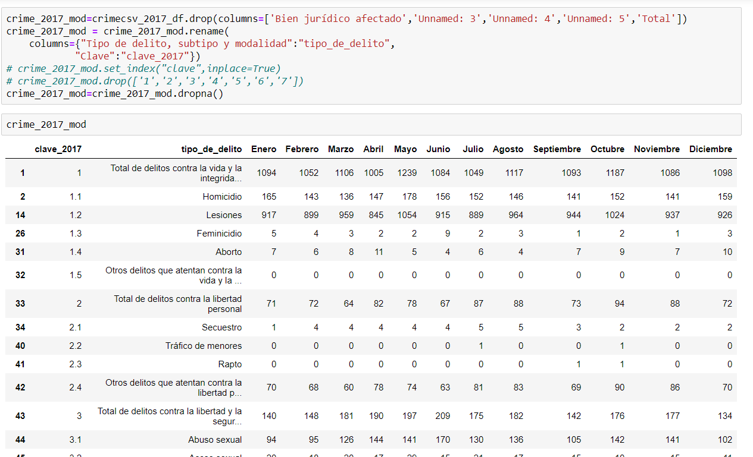

Slide 5
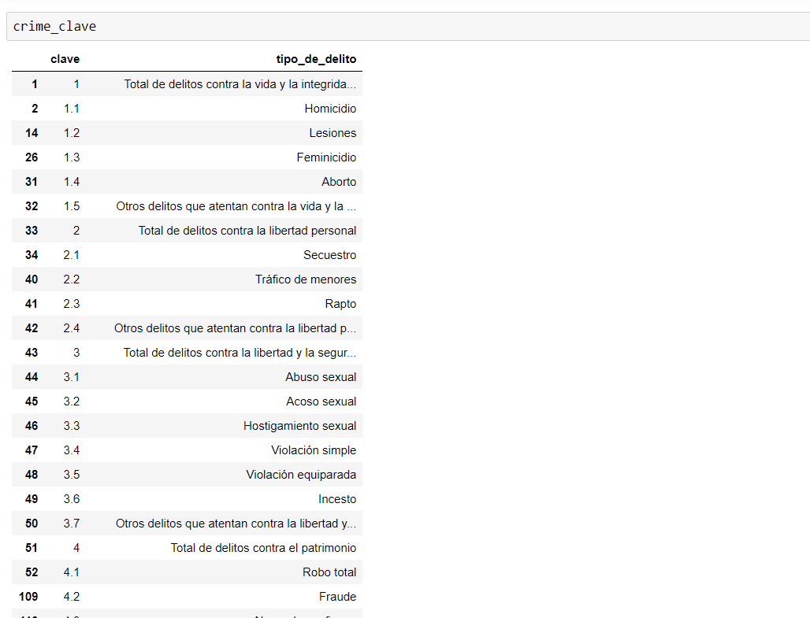

Slide 6


Slide 7
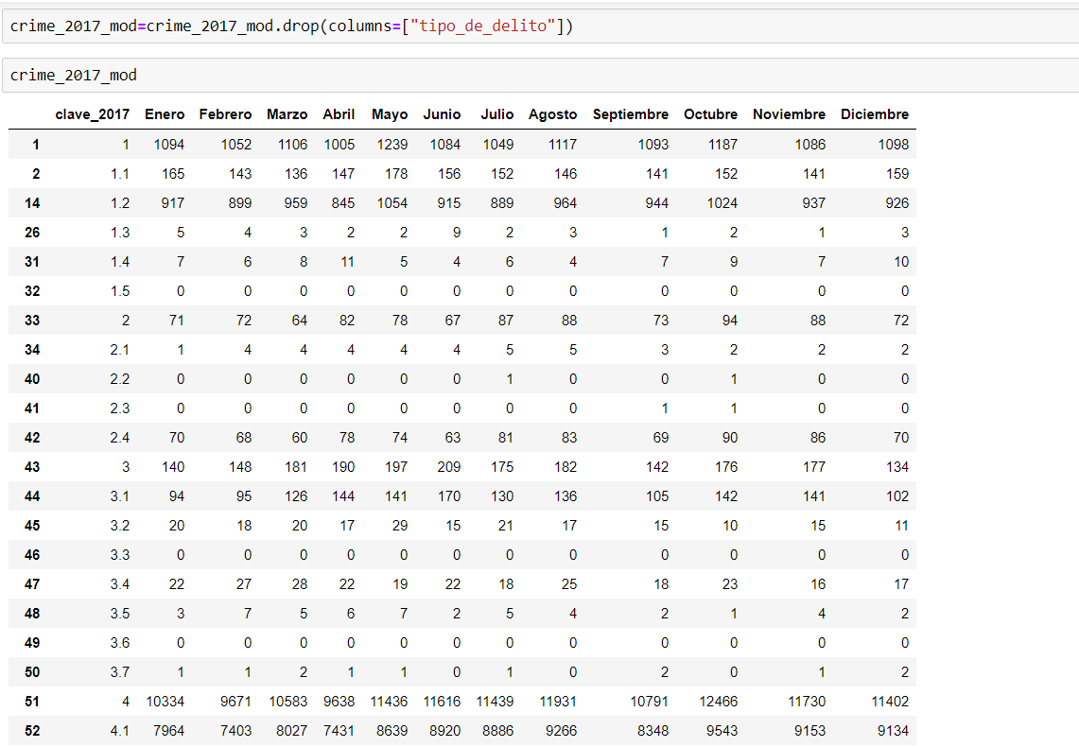

Slide 8
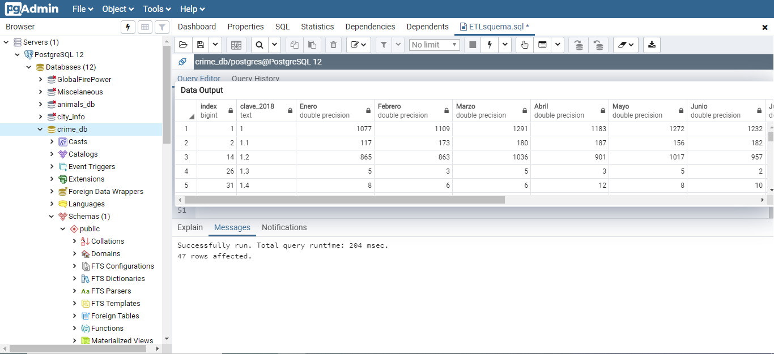

Slide 9
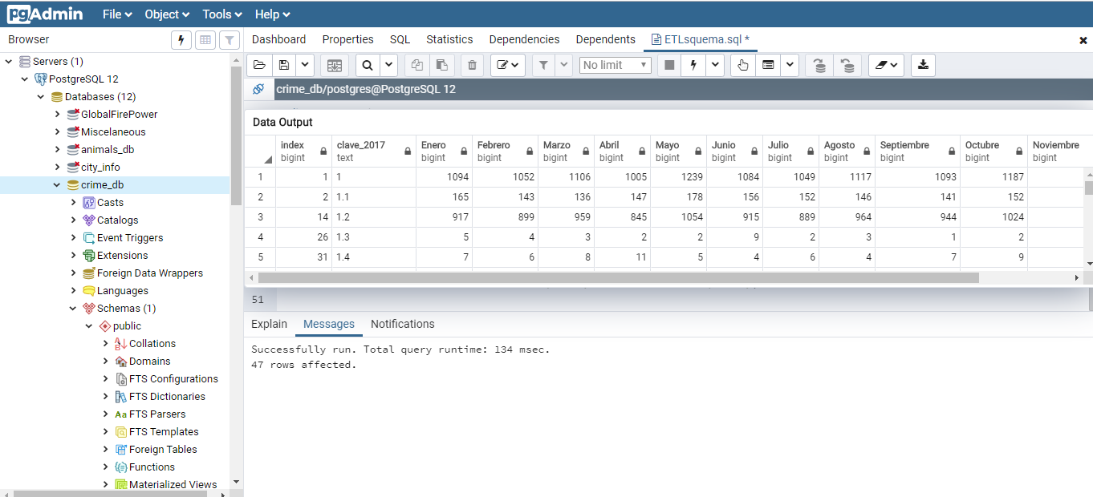

Slide 10
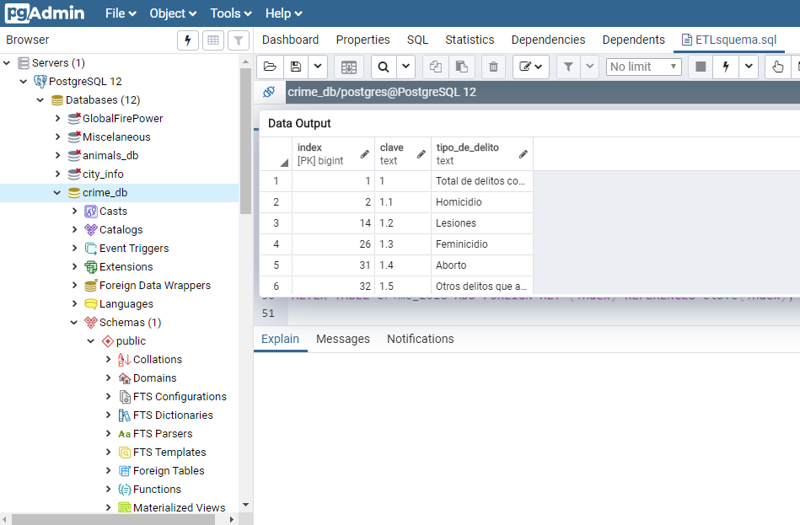

Slide 11


Slide 12
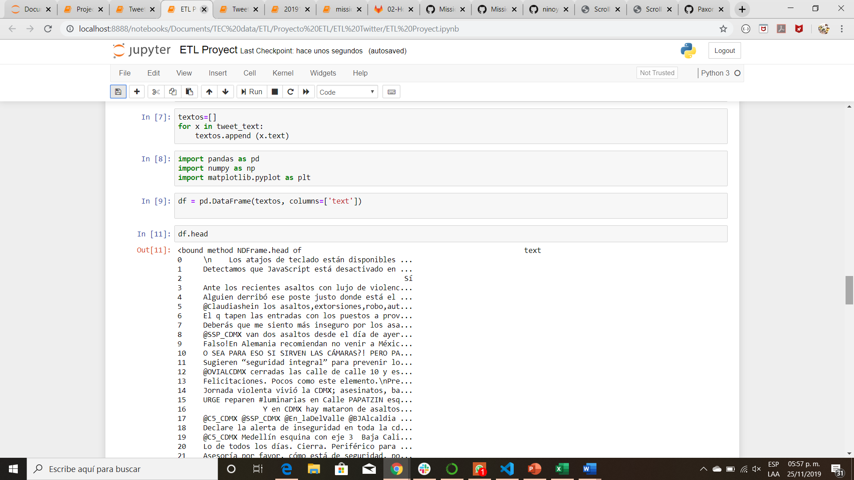

Slide 13
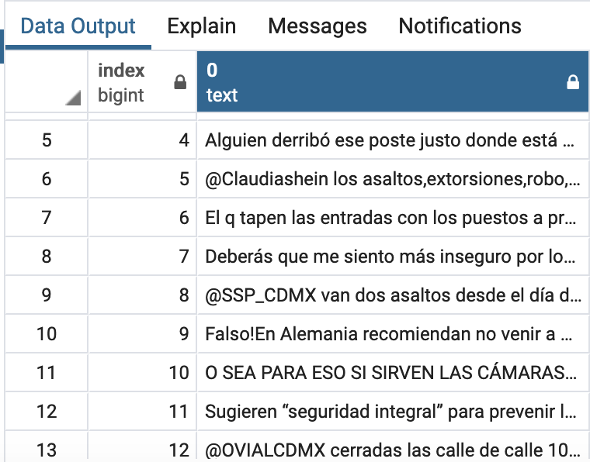


Slide 14



